Slide 1
Heuristics
Anuj Pathania

Slide 2
Lesson Objectives (Learning Goals)
Define and differentiate between different optimization problems.
Calculate and appreciate a problem’s state space.
Recognize the vital role of Heuristics in exploring the state space.
Abstract out the shape (properties) of a state space.

Slide 3
Optimization Fundamentals
Company produces two types of Chocolate A and B.
A requires 1 unit of milk and 3 units of choco.
A sells for 6 Euro.
B requires 1 unit of milk and 2 units of choco.
B sells for 5 Euro.
Company has 5 units of milk and 12 units of choco.
How many units of A and B should be produce to maximize sale?

Slide 4


Optimization Fundamentals
Maximize Profit $P=6A+5B$
Linear
Programming
Such That,
$A+B$≤$5$ [Limited Milk Supply]
$3A+2B \text{≤}12$ [Limited Coco Supply]
$A$ ≥ 0 & $B$ ≥ 0 [Non-Negative Chocolate Production]

Slide 5






Optimization Fundamentals
What is an optimization problem?
The problem of finding the best solution among all the feasible solutions.
Can be continuous or discrete.
$$B$$
Optimal
Solution
$3A+2B \text{≤}12$
$B$ ≥ 0
Feasible
Solutions
$A+B$≤$5$
$A$ ≥ 0
$$A$$

Slide 6

Optimization Fundamentals
What is an optimization variable?
Variable whose value can be optimized to solve the optimization problem.
Also known as decision variable.
$$A \& B$$

Slide 7

Optimization Fundamentals
What is an objective function?
A mathematical function which quantizes the quality of a solution.
Must be satisfied, maximized, or minimized.
Maximize Profit $P=6A+5B$

Slide 8

Optimization Fundamentals
What is a constraint?
Mathematical equalities and inequalities that defines the domain of optimization variables.
Feasible solution must satisfy the constraints.
Such That,
$A+B$≤$5$ [Limited Milk Supply]
$3A+2B \text{≤}12$ [Limited Coco Supply]
$A$ ≥ 0 & $B$ ≥ 0 [Non-Negative Chocolate Production]

Slide 9
Three Types of Optimization Problems
Free Optimization Problem (FOP)
Constraint Optimization Problem (COP)
Constraint Satisfaction Problem (CSP)

Slide 10
Free Optimization Problem (FOP)
Outlier
Bunch of (X,Y) coordinates. Can you find the linear equation that best captures relationship between X & Y?

Slide 11

Free Optimization Problem (FOP)
$$Minimize \frac{\text{∑ (}\text{yactual}\text{ – }\text{y} \text{predicted}\text{)}\text{2}}{n}$$
Easily solved using linear regression by minimizing Mean Square Error.

Slide 12
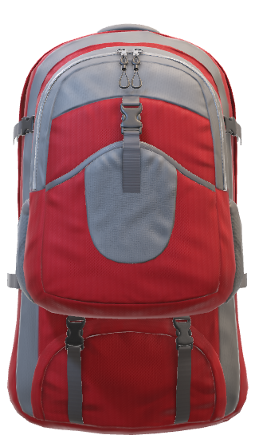
Constraint Optimization Problem (COP)
€ 4 (12 kg)
Objective: Maximize €
Constraint: Weight < 15 kg.
€ 10 (4 kg)
€ 2 (2 kg)
15 kg
€ 2 (1 kg)
€ 1 (1 kg)
Choose boxes that maximize the € value while weight is less than capacity of bag (One Dimensional Knapsack).

Slide 13
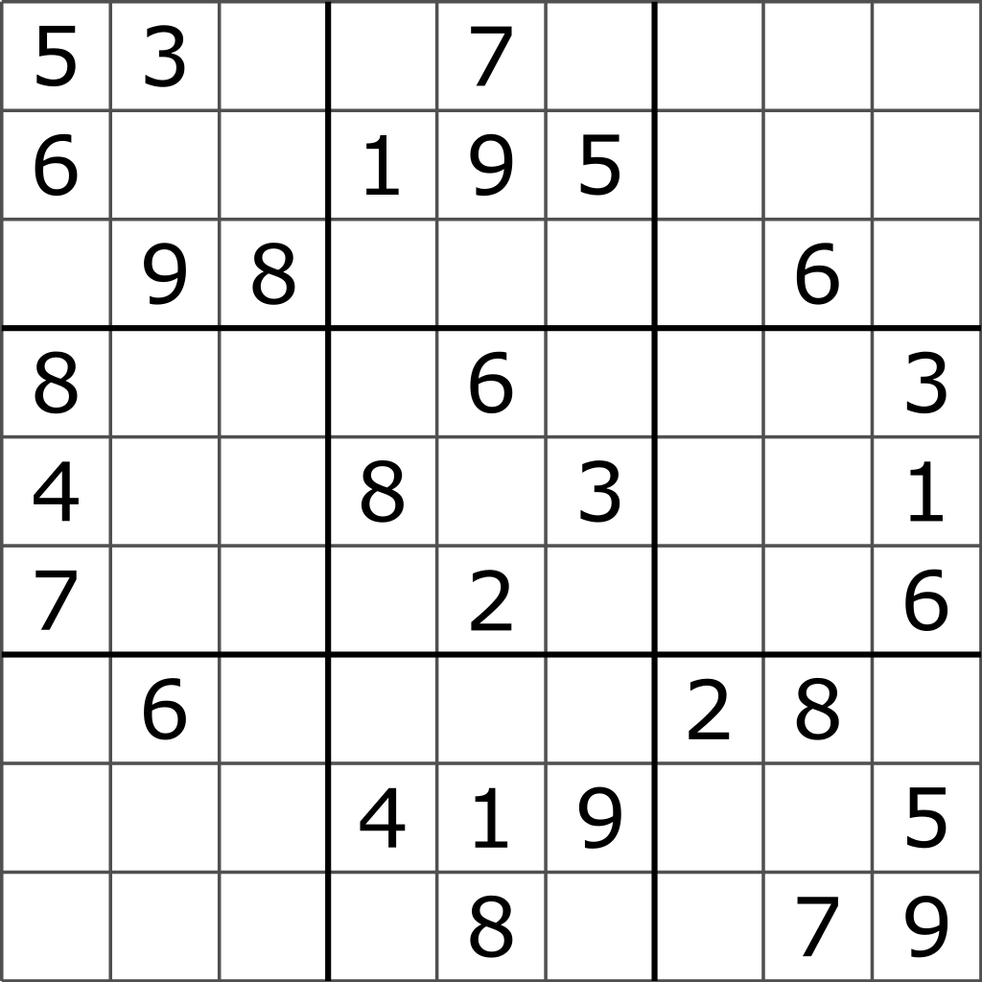
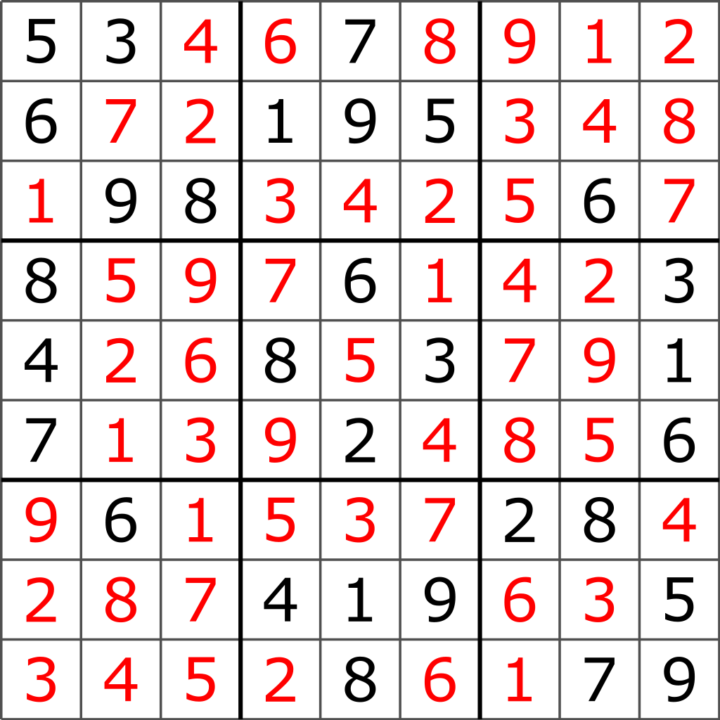
Constraint Satisfaction Problem (CSP)
Solve Sudoku exactly without violating Sudoku row, column, and box constraint.

Slide 14
Summary: Three Types of Optimization Problems
 | No Constraint | Constraint
No Satisfaction | Free Optimization Problem (FOP) | Constraint Optimization Problem (COP)
Satisfaction |  | Constraint Satisfaction Problem (CSP)

Slide 15
Poll
Are there any satisfiable problem that have no constraints?
Yes or No

Slide 16
Questions?

Slide 17
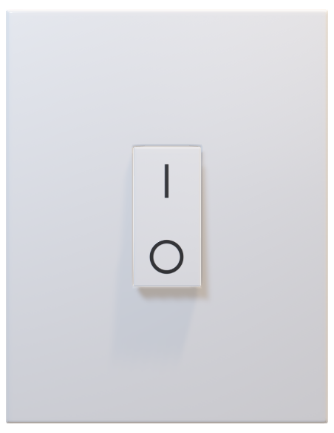
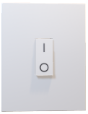
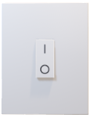
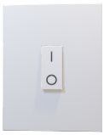
State Space
State Space Size
1 - Switch
2
2 - Switches
4
3 - Switches
8
On or Off
4 - Switches
16
n - Switches
2^{n}
…..
Set of all possible configurations of a problem.

Slide 18
Exponential State Space

Slide 19
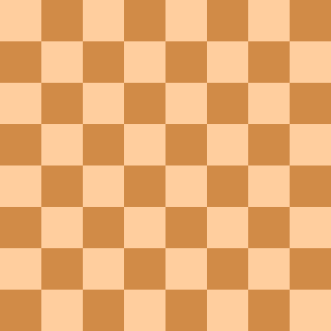

State Space
N-Queen Puzzle.

Slide 20

State Space
1st Queen: 64 Squares
2nd Queen: 63 Squares
3rd Queen: 62 Squares
4th Queen: 61 Squares
5th Queen: 60 Squares
6th Queen: 59 Squares
7th Queen: 58 Squares
8th Queen: 57 Squares
Total Ways = 64 * 63 * 62 * 61 * 60 * 59 * 58 * 57 = 4426165368 = $\left({64 \atop 8}\right)$
8-Queen Puzzle.
$\left({n \atop k}\right)$ = $\frac{\text{n}\text{!}}{\text{(}\text{n}\text{−}\text{k}\text{)!}}$
Where,
n is number of squares
k is number of queens

Slide 21
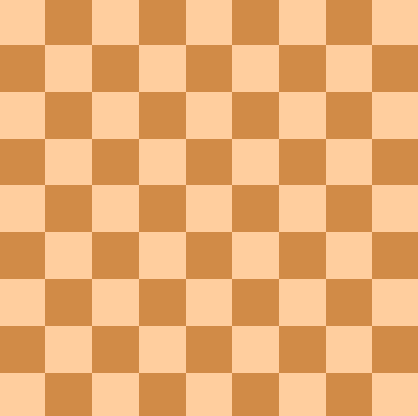
State Space
$\left({64 \atop 8}\right)$ = 4426165368
$\left({81 \atop 9}\right)$ = 260887834350
8-Queen Problem:
9-Queen Problem:

Slide 22
State Space
Queens | Squares | State Space | Approximate Time to Solve
8 | 64 | 4426165368 | 4.42 Seconds
9 | 81 | 260887834350 | 4.34 Minutes
10 | 100 | 17310309456440 | 4.8 Hours
11 | 121 | 1276749965026540 | 14.77 Days
12 | 144 | 103619293824707000 | 39.40 Months
13 | 169 | 9176358300744340000 | 290.78 Years
14 | 196 | 880530516383349000000 | 27 902.92 Years
15 | 225 | 91005567811177500000000 | 2 883 854.02 Years
16 | 256 | 10078751602022300000000000 | 319 383 187 Years
17 | 289 | 1190739044344490000000000000 | 3.77330493 × 10¹⁰ Years
18 | 324 | 149482492334195000000000000000 | 4.73691552 × 10¹² Years
19 | 361 | 19870867053543800000000000000000 | 6.29683229 × 10¹⁴ Years
20 | 400 | 2788360983670900000000000000000000 | 8.83597149 × 10¹⁶ Years

Slide 23
Factorial (N-Queen) State Space

Slide 24
Summary: State Space Comparison

Slide 25
Questions?

Slide 26
Coffee Break!
(10 Mins)

Slide 27

Computer Algorithm
Algorithm is a sequence of well-defined steps a computer can follow in order to solve a problem.
Bubble Sort: An algorithm to sort a set of number.
Step 1: Iteratively compare adjacent pair of numbers.
Step 2: Swap numbers if not in correct order.
Step 3: Repeat until there is no more swapping.

Slide 28
Computational Complexity
2,1,3,4,5,6,7,8,9,10
Bubble Sort (1 Step)
Best-Case
1,2,3,4,5,6,7,8,9,10
Bubble Sort (<=100 Steps)
10,9,8,7,6,5,4,3,2,1
Worst-Case
Primary Focus on Worst-Case

Slide 29
Problem Complexity
Worst Case Complexity: Big O Notation → O(…)
🙂
☹
O (n…)
Polynomial
O(…^{n})
Exponential
“n” is the length of the input.

Slide 30
Polynomial vs Exponential
As computers get faster, even very large polynomial problems solve quickly. However, exponential problems remain intractable even with small inputs.

Slide 31
Fast Algorithms
Bubble Sort
O (n^2)
Quick Sort
O (n ln n)
Sorting
Fast Algorithm
Faster Algorithm
🙂
Fast Algorithm
???
Sudoko
(And Lots of Other Very Important Problems)
☹

Slide 32
What’s the Solution?
Heuristics
Smart and fast algorithms that provide a near-optimal solution in a reasonable amount of time for COP problems.

Slide 33
Sudoko is Special!
Difficult To
Solve
Easy to Check
Source: Wikipedia

Slide 34
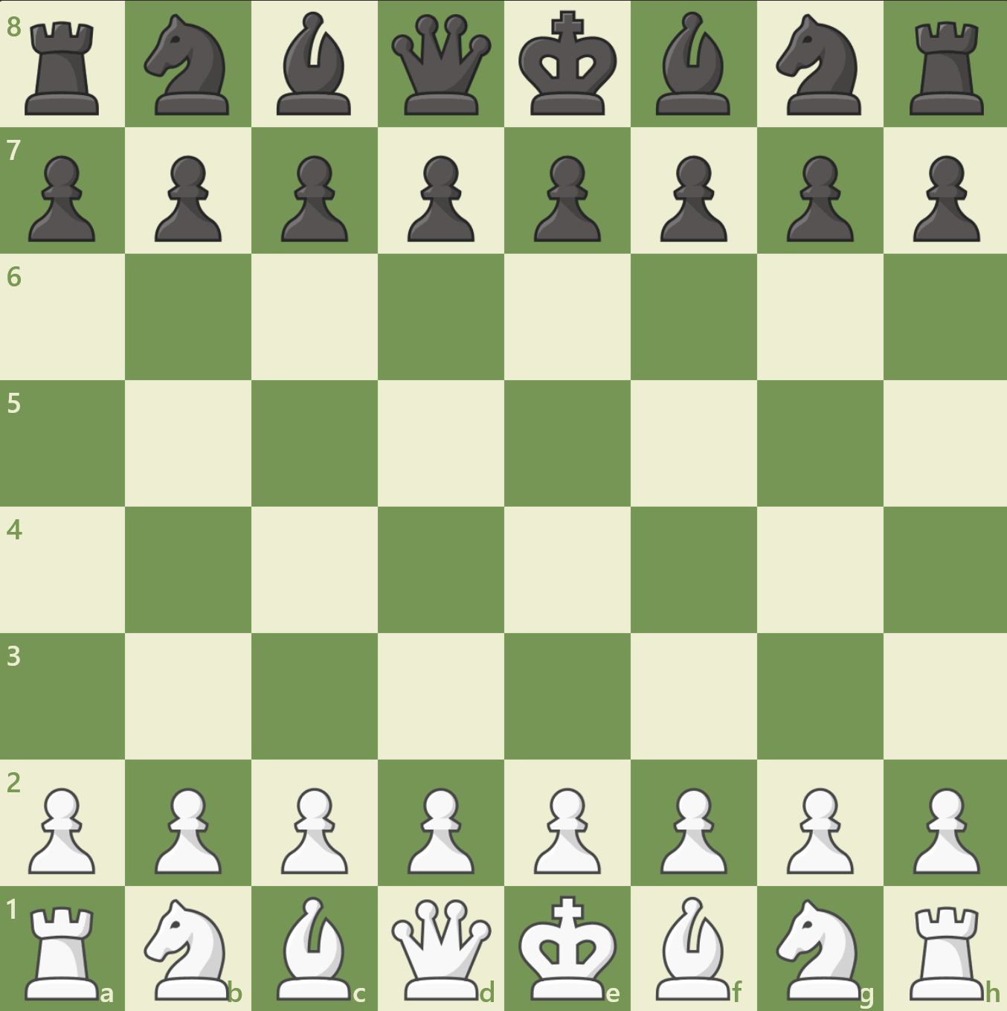
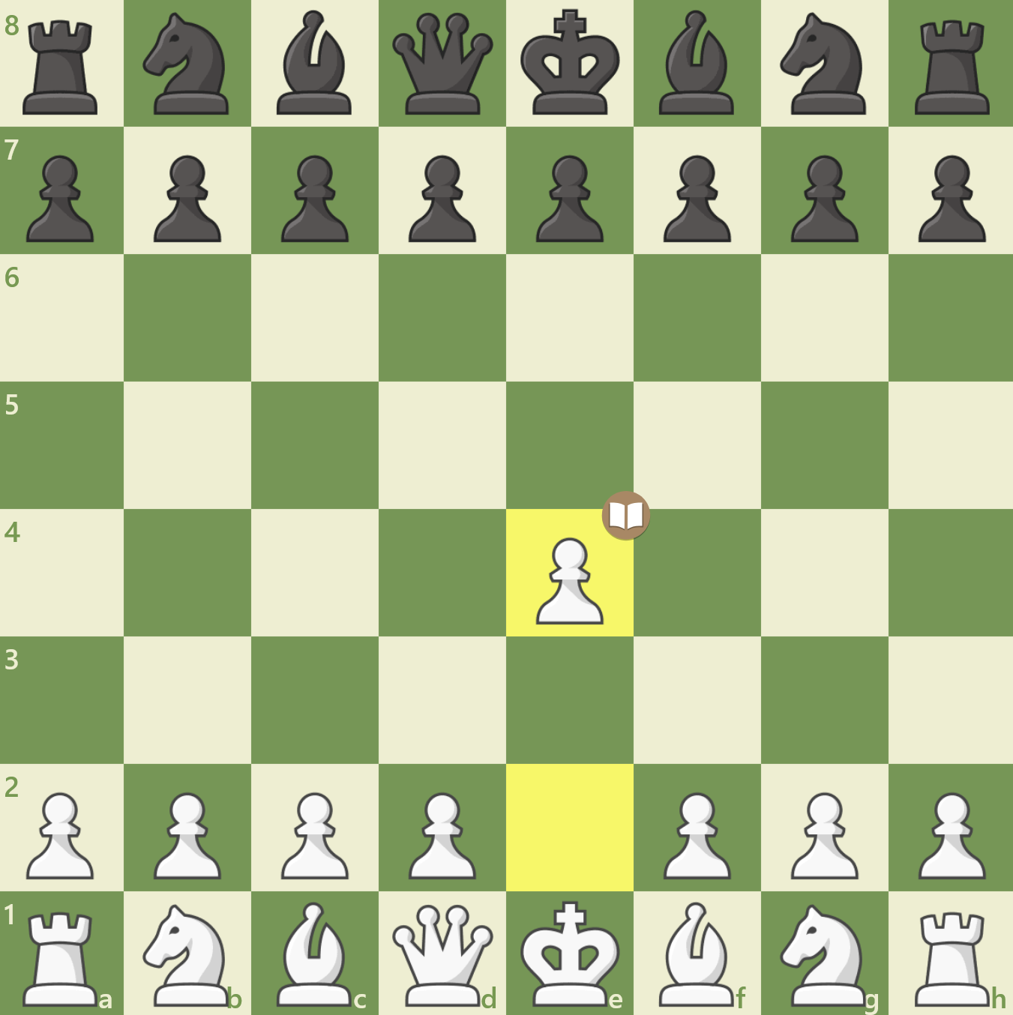
Chess is Harder!
Difficult To
Solve
Difficult To
Check
Is this (E4) the best chess opening for White?

Slide 35
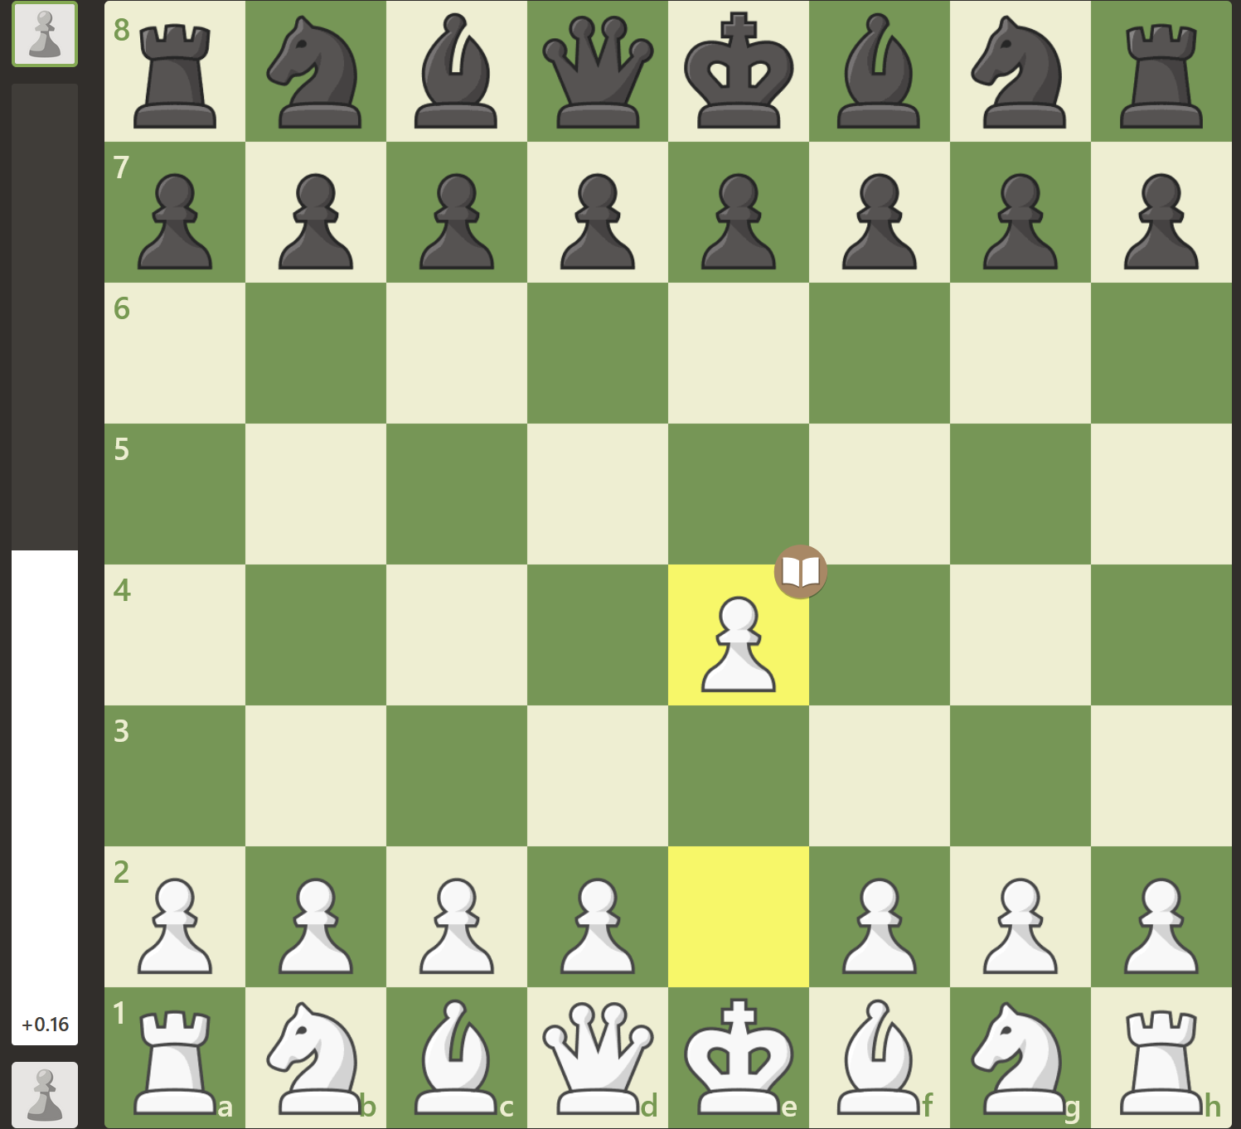
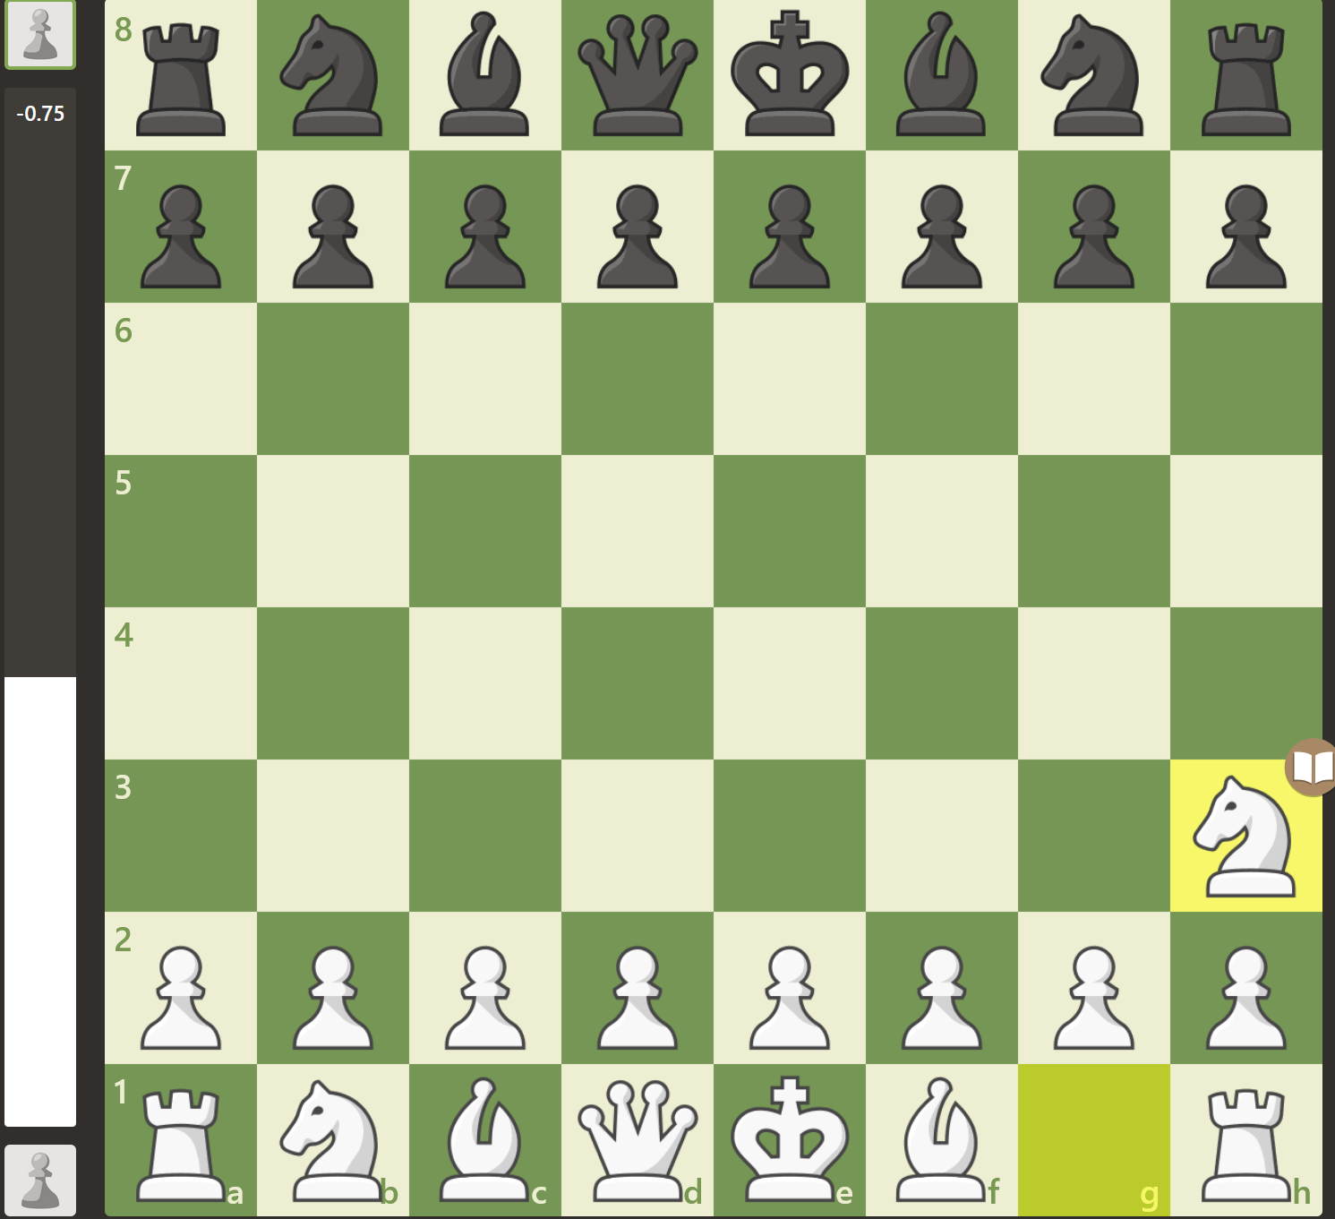
Heuristics in Chess
Good Opening (+0.16)
Bad Opening (-0.75)
Chess engines use heuristic objective functions to score positions.

Slide 36
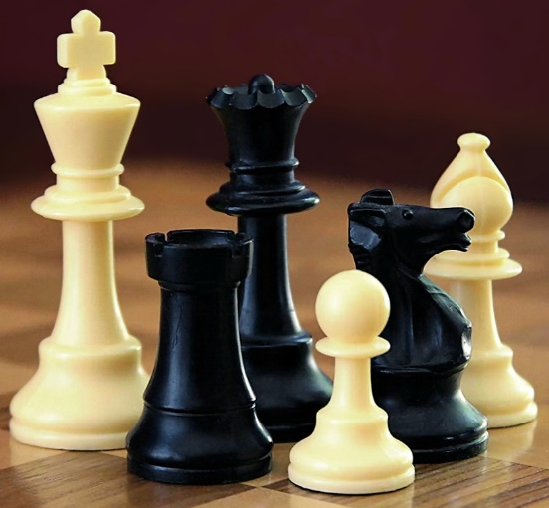
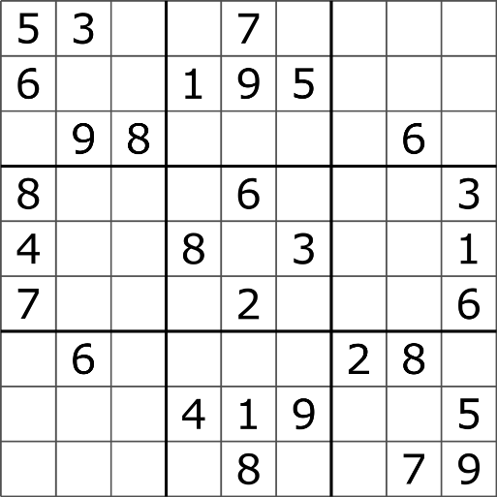
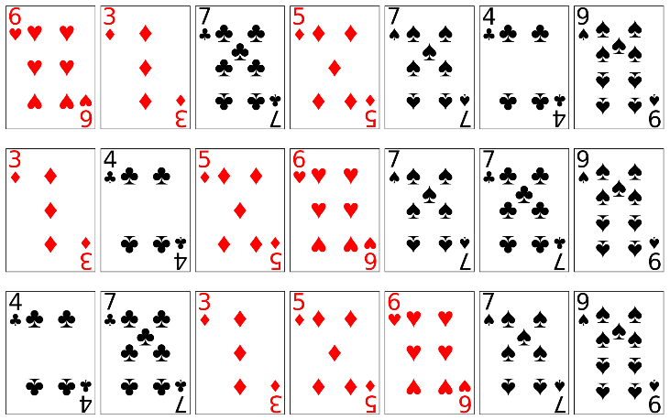
Summary: Problem Difficulty and Heurisitics
Chess
Sudoku
Sorting
Hard
???
Easy
Source: Wikipedia

Slide 37
Poll
What’s your estimate of the difficulty of Sudoko puzzle?
Easy as Sorting or Hard as Chess

Slide 38
Questions?

Slide 39
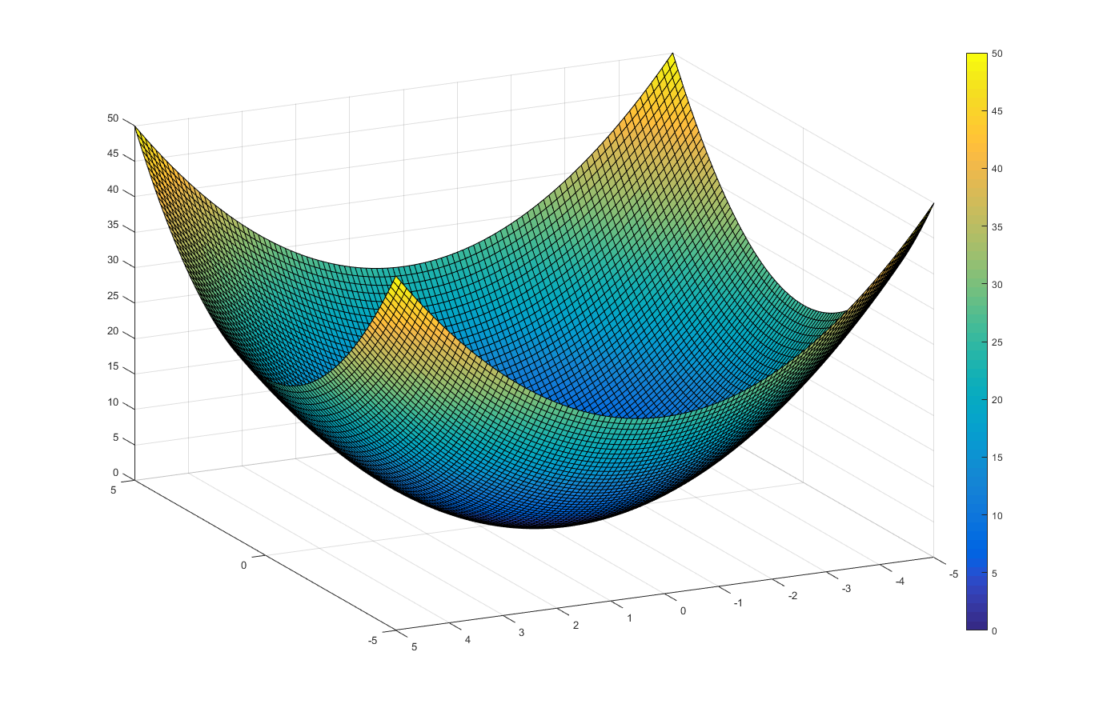
Convex State-Space (Global Minima)

Slide 40

Gradient Descent to Global Minima
$$Minimize y=x2$$

Slide 41

Gradient Ascent to Global Maxima
$$Maximize y=−x2$$

Slide 42
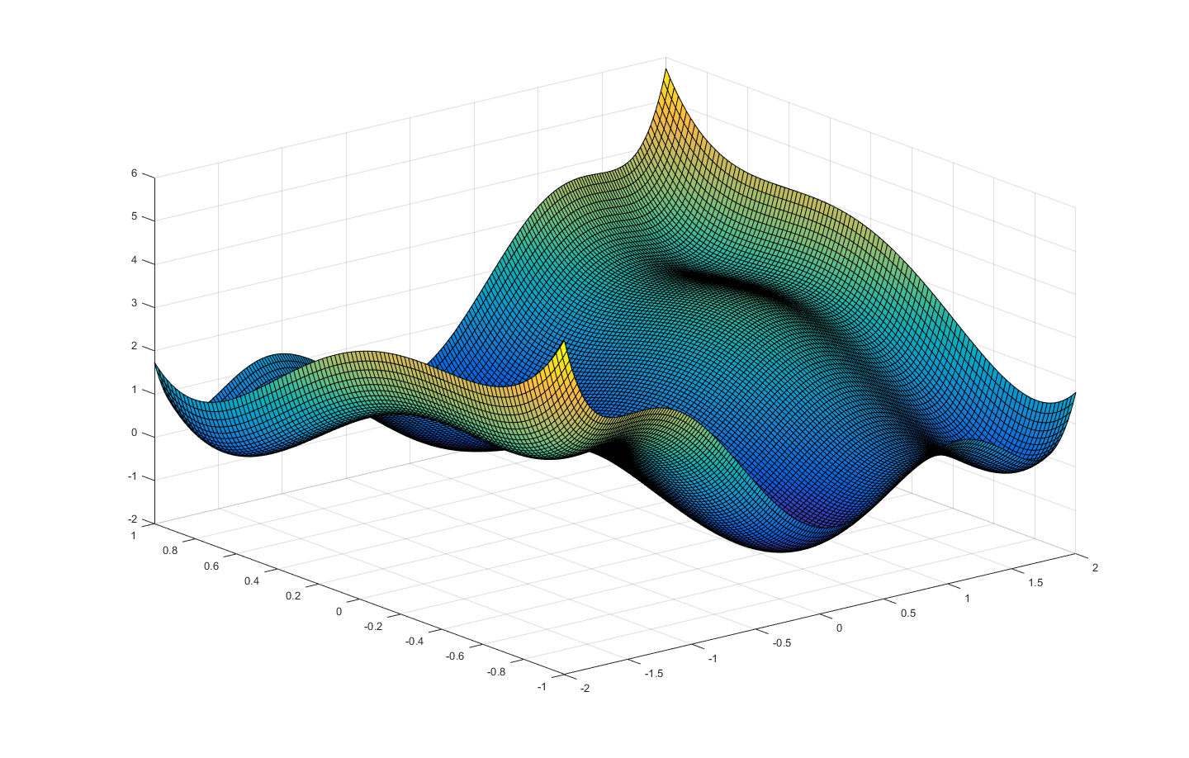
Non-Convex State-Space (Local Minima)

Slide 43
Gradient Descent to Local Minima

Slide 44
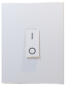


Turn On All Switches
3 Switches → 2³ or 8 States

Slide 45
Summary: Global Minima vs Local Minima
 | Exploration Difficulty | Minima | Solution Quality
Convex State-Space | Easy | Global Minima | Optimal
Non-Convex State-Space | Hard | Local Minima | Sub-Optimal

Slide 46
Questions?

